Slide 1
How Do You Teach What Data Are in 120+ Censuses and Surveys? You Don’t!
June 8, 2022
Mary Leisenring, Census Academy Lead U.S. Census Bureau mary.w.leisenring@census.gov
Eric Coyle, Intergovernmental Affairs Specialist U.S. Census Bureau eric.a.coyle@census.gov
Logan Powell, Developer Experience Lead U.S. Census Bureau logan.t.powell@census.gov
1

Slide 2


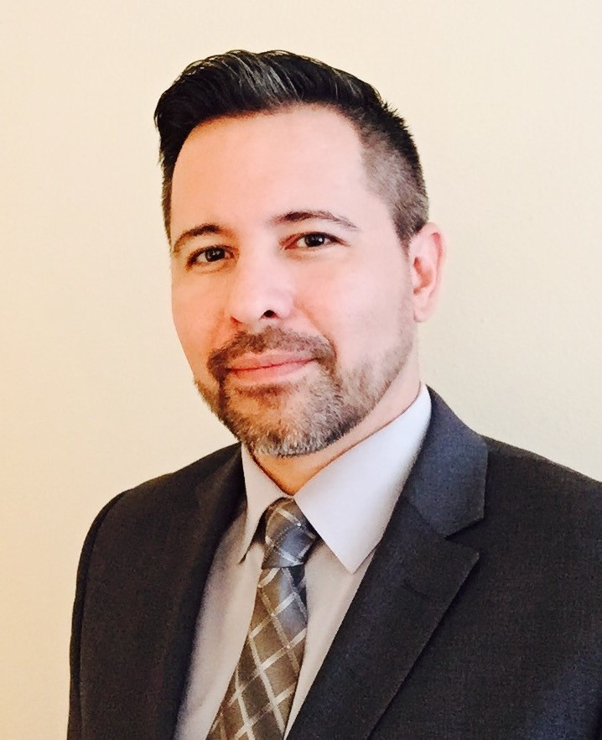

Meet Your Presenters
Mary Leisenring is the Census Academy Lead. This program focuses on digital education product development that teaches the public how to find and use Census Bureau data. As a cofounder of Census Survey Explorer (CSE), she manages the project and the tool.
Eric Coyle is an Intergovernmental Affairs Specialist. He is a cofounder of CSE and served an instrumental role as a subject matter expert on Census Bureau surveys, programs, and data.
Logan Powell is a Developer Experience Lead. He served as a mentor and consultant for CSE and took over the developer role for the prototype.

Slide 3



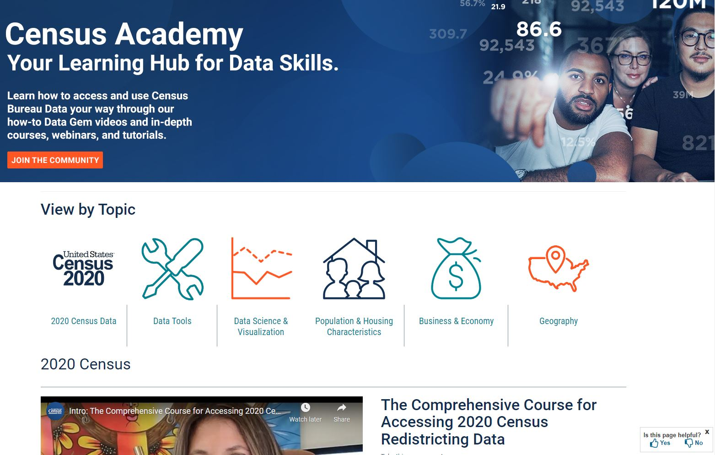
Our Products
Census.gov/Academy
Data Gem
Courses & Tutorials
Webinars and Webinar Series
Request a Training
3

Slide 4
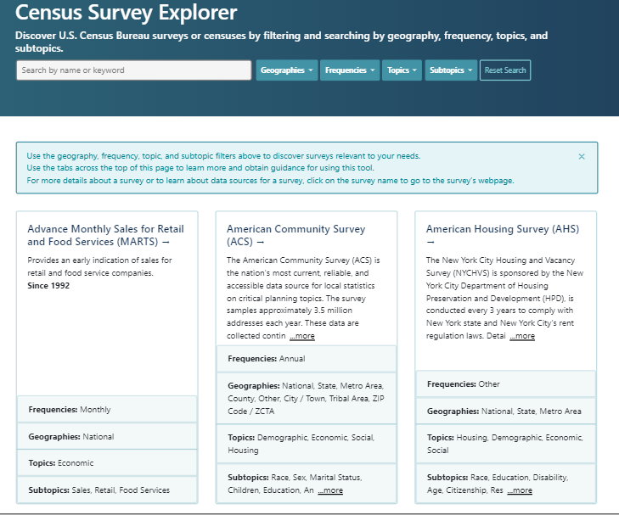
Let’s Talk About What We Are Going to Talk About
Origin story
Then vs. now survey discovery demo
Development process
Tool demo
Integrated marketing strategy
Q&A
census.gov/SurveyExplorer
4

Slide 5
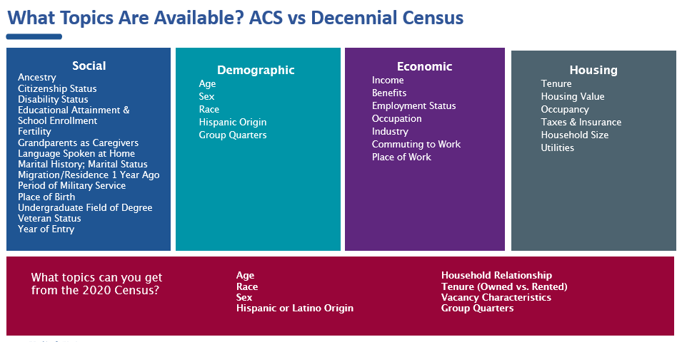
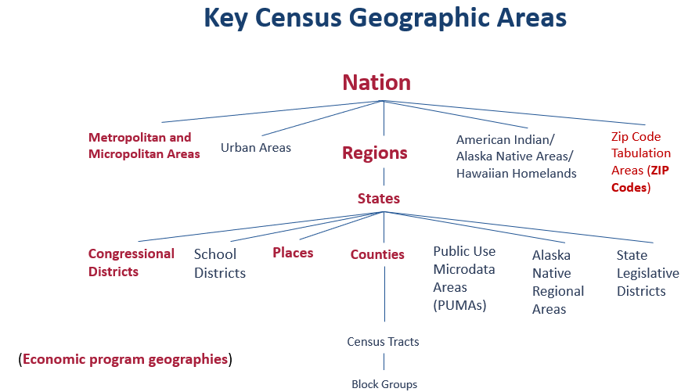
Origin Story: How do I know what survey(s) have the data I need?
Some of the best innovations originate from real life encounters with a problem or bad experience.
What geography?
How recent is the data?
How far back does the data go?
Which topics are available in which survey?
5

Slide 6

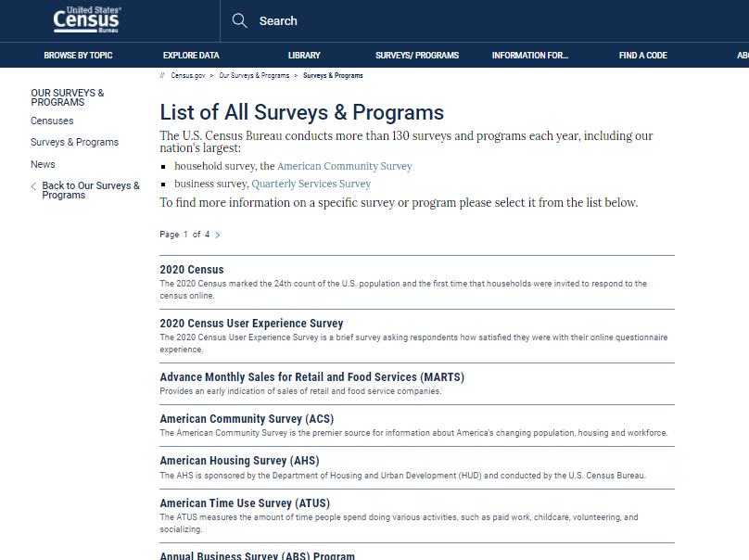
Past User Experience
Need to convey info for several pages of Censuses and Surveys​
In the list pages, survey names and descriptions are limited, requiring several clicks to discover topics, geographies, and frequency for each survey​
Mastery of this topic was too much to expect from a learner​
Topic overlap across some surveys adds confusion​
A static infographic wasn’t cutting it​
6

Slide 7
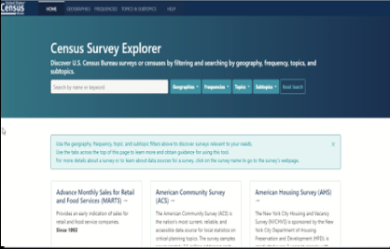
Present User Experience
Offers complete and fast baseline of (linked) surveys to do a deeper dive
HCD: Fuller view of most sought-after info available data at a glance
Survey metadata and full descriptions now visible (better searchability)
Equitable to all data seekers/surveys

Slide 8
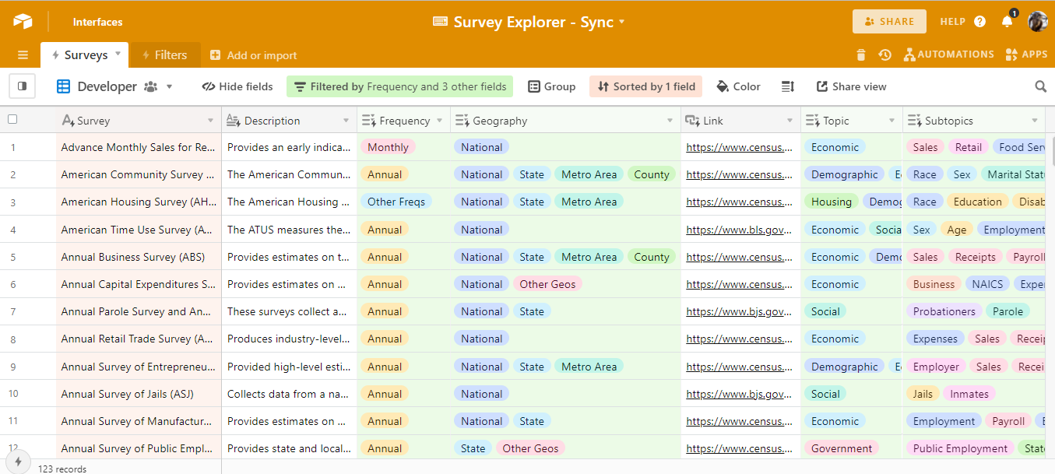
Process: Researched and Added Meta Data to Each Survey
8

Slide 9
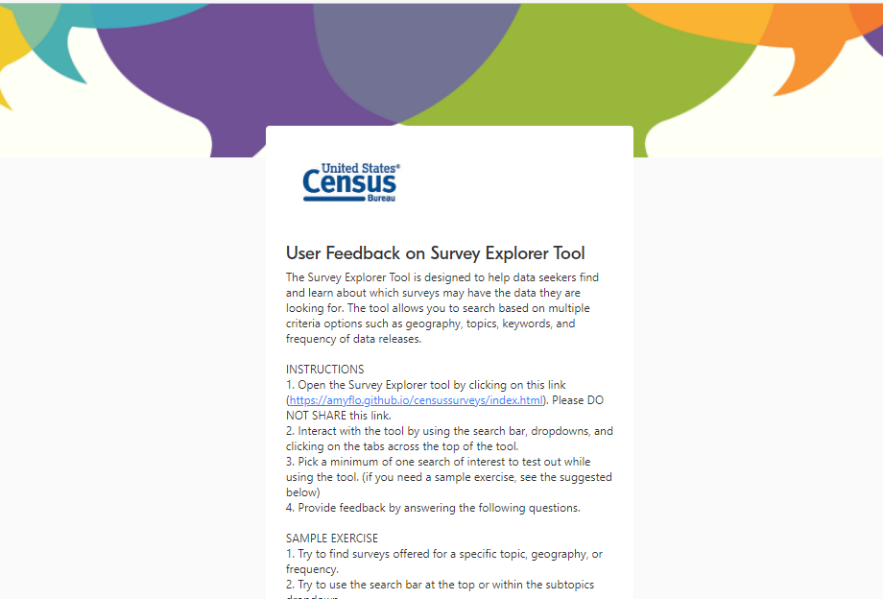
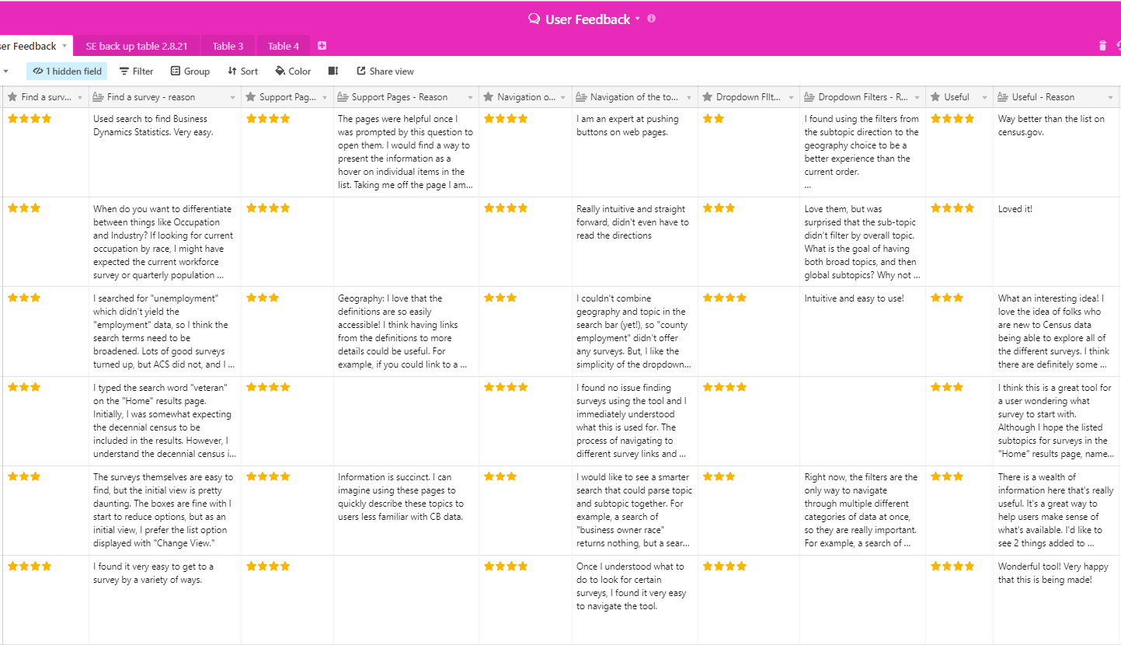
User Experience Feedback
9

